Slide 1
Introduction to DevOps
Sonika Rathi
Assistant Professor
BITS Pilani

Slide 2
Agenda
Agile Methodology SCRUM
Scrum

Slide 3
SCRUM Methodology
About Scrum
Scrum is part of the Agile movement
Scrum is an agile way to manage a project, usually software development
Scrum’s early advocates were inspired by empirical inspect and adapt feedback loops to cope with complexity and risk
Scrum emphasizes decision making from real-world results rather than speculation
By Mountain Goat Software – Pioneer of Agile
“Agile software development with Scrum is often perceived as a methodology; but rather than viewing Scrum as methodology, think of it as a framework for managing a process”

Slide 4
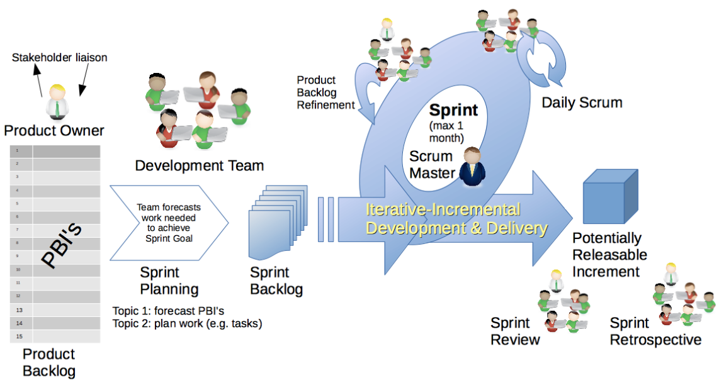
SCRUM
Scrum Sprints

Slide 5
SCRUM
Benefits of Scrum
Flexibility
Quality
Incremental Working Product
Early to Market

Slide 6
Thank You!
In our next session:

